Slide 2

ISN’T THIS A PROBLEM?
Notes:
In those strategies, a complex single “i-classification” task is decomposed into “i” twoclassification subtasks.

Slide 5

DEALING WITH IMALANCED DATA
IMBALANCED CLASSES ARE A COMMON PROBLEM IN MACHINE LEARNING CLASSIFICATION WHERE THERE ARE A DISPROPORTIONATE RATIO OF OBSERVATIONS IN EACH CLASS
Notes:
© Copyright Showeet.com – Creative & Free PowerPoint Templates

Slide 6

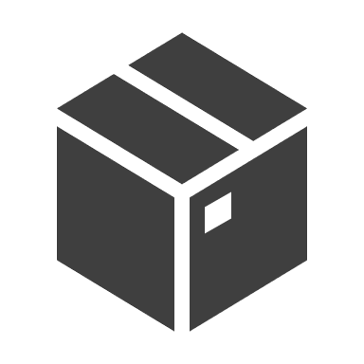

MEDICAL DIAGNOSIS
PRODUCT DEFECTION
FRAUD DETECTION

Slide 7

It doesn’t seem fair that you have to pay so much if you’ve been cautious on the road for years.
Porto Seguro, one of Brazil’s largest auto and homeowner insurance companies, completely agrees. Inaccuracies in car insurance company’s claim predictions raise the cost of insurance for good drivers and reduce the price for bad ones.

Slide 8



Slide 9
5 steps to build a model
Gather data
Explore data
Test model
STEP 02
STEP 04
STEP 01
STEP 05
STEP 03
Preprocess data
Choose model

Slide 10


Reworking dataset
Reworking model

Slide 11
Reworking dataset
Downsampling
Oversampling
Hybrid

Slide 12
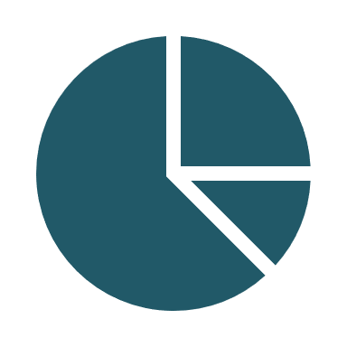


Downsampling
Consists of reducing the ratio of the dominant class in our sample
Undersampling can be a good choice when you have a ton of data -think millions of rows. But a drawback is that we are removing information that may be valuable. This could lead to underfitting and poor generalization to the testing set.

Slide 13
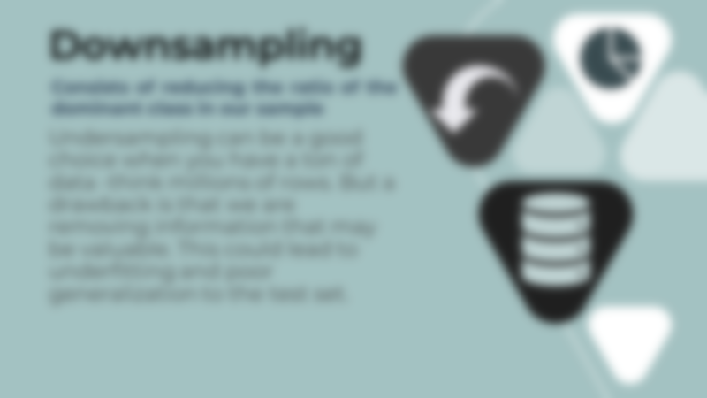

Slide 15

Tomek links
Tomek links are pairs of very close instances, but of opposite classes. Removing the instances of the majority class of each pair increases the space between the two classes, facilitating the classification process.

Slide 16


Slide 18
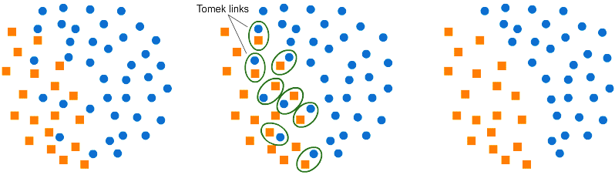

THIS COULD BE
A DECISION BOUNDARY

Slide 19

Cluster centroids undersampling
CCU uses the concept of finding cluster centroid, as already instances are labelled. The cluster centroid is found by obtaining the average feature vectors for all the features, over the data points belonging to the majority class in feature space.
After finding the cluster centroid of the majority class, the instance belonging to the cluster (majority class), which is farthest from the cluster centroid in feature space, is considered to be the most unimportant instance. On the contrary, the instance belonging to the majority class, that is nearest to the cluster centroid in feature space, is considered to be the most important instance.
So, in CCMUT, instances belonging to the majority class are removed on the basis of their importance and number of samples to be under-sampled depends upon the % of Under-sampling or CCMUT.

Slide 20

Cluster centroids undersampling
After finding the cluster centroid of the majority class, the instance belonging to the cluster (majority class), which is farthest from the cluster centroid in feature space, is considered to be the most unimportant instance. On the contrary, the instance belonging to the majority class, that is nearest to the cluster centroid in feature space, is considered to be the most important instance.

Slide 21
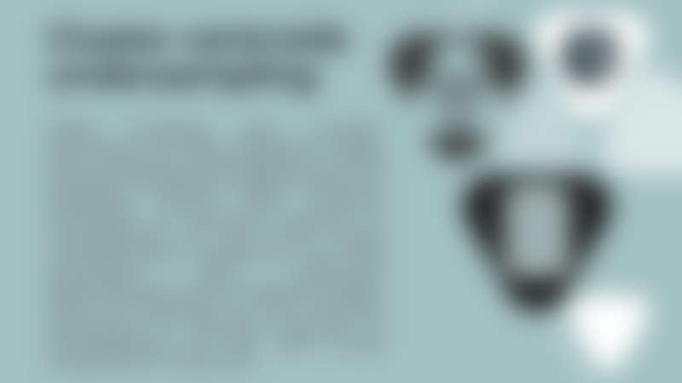

Slide 23
NearMiss
NearMiss aims to balance class distribution by randomly eliminating majority class examples. When instances of two different classes are very close to each other, we remove the instances of the majority class to increase the spaces between the two classes. To prevent problem of information loss in most under-sampling techniques, near-neighbor methods are widely used.

Slide 24
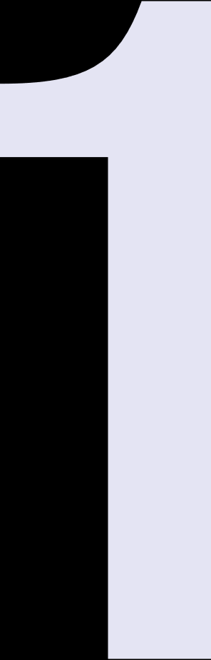


NearMiss
Step 1
Step 2
Step 3
The method first finds the distances between all instances of the majority class and the instances of the minority class. Here, majority class is to be under-sampled.
Then, n instances of the majority class that have the smallest distances to those in the minority class are selected.
If there are k instances in the minority class, the nearest method will result in k*n instances of the majority class.

Slide 25
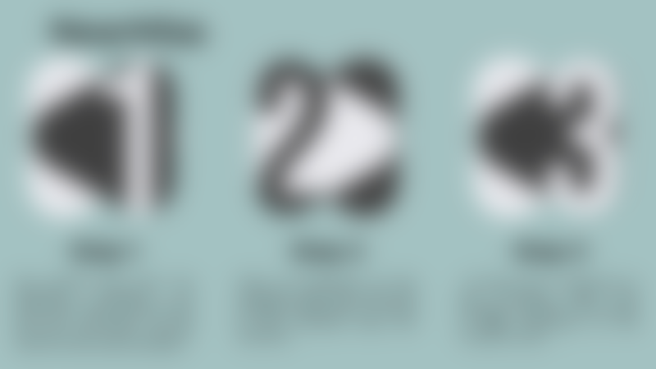

Slide 26
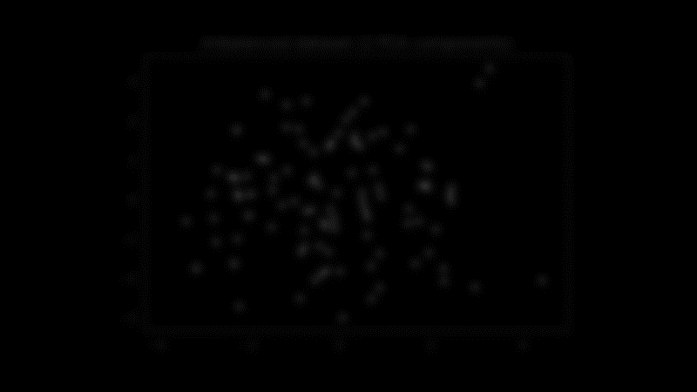
The choice depends on which NearMiss version we’re using

Slide 27
Version 1
Version 2
Version 3

Slide 28
Version 1
Version 2
Version 3

Slide 29
Version 1
Version 2
Version 3

Slide 30
Version 1
Version 2
Version 3

Slide 31






NearMiss
Condensed Nearest Neighbor Rule
Edited Nearest Neighbor Rule
Cluster Centroid (KNN)
Cluster Centroid (K-means)
Tomek Links
Random Undersampling
Neighborhood Cleaning Engine
Notes:
Other models

Slide 32
Oversampling
can be defined as adding more copies of the minority class.
Oversampling can be a good choice when you don’t have a ton of data to work with.
Oversampling before splitting the data can allow the exact same observations to be present in both the test and train sets. This can allow our model to simply memorize specific data points and cause overfitting and poor generalization to the testing data.
Always split into test and train sets BEFORE trying oversampling techniques!
Notes:
So far we have seen techniques that undersample the majority class, s instead of reducing the ratio of the majority class what if we were able to increase the propotion f the minority class which is oversampling.

Slide 33

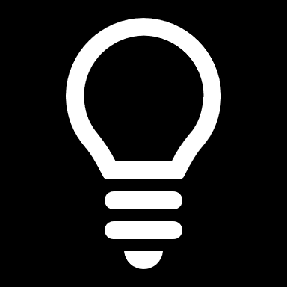
Oversampling
Tip:
Always split into testing and training sets BEFORE trying oversampling techniques!
can be defined as adding more copies of the minority class.
Notes:
In other words if you have have an imbalanced dataset and yu want to use oversampling first thing u have to do is splitting the data then apply oversampling technique only on the training set and after generating the mdel use the testing set to measure the performance of ur model

Slide 34
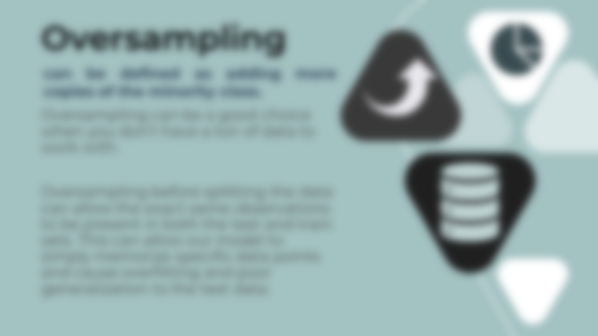

Slide 36
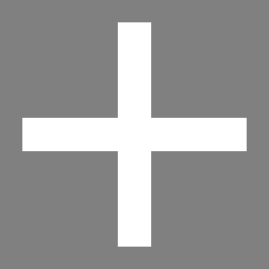
Generating synthetic data
A technique similar to upsampling is to create synthetic samples. Here we will use SMOTE or Synthetic Minority Oversampling Technique. SMOTE uses nearest neighbors algorithm to generate new and synthetic data we can use for training our model.
Notes:
So that being said lets have a look at some techniques
Generating synthetic data its kind of the same concept , but instead of duplicating data, we generate new points that are very likely to belong to minority class

Slide 37
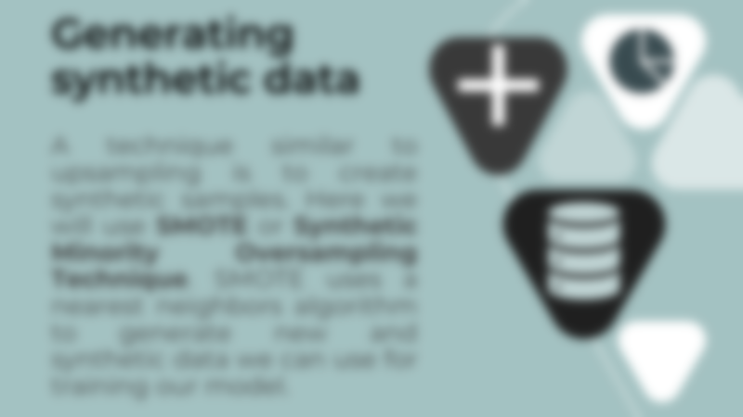
Synthetic Data

Slide 38
Synthetic Data

Slide 39

Adaptive Synthetic Sampling Approach
The major difference between SMOTE and ADASYN is the difference in the generation of synthetic sample points for minority data points. In ADASYN, we consider a density distribution rₓ which thereby decides the number of synthetic samples to be generated for a particular point, whereas in SMOTE, there is a uniform weight for all minority points.
Notes:
Another approach which is adasyn this approach generates synthetic data in a way that help to prevent the noise and outliers.

Slide 40
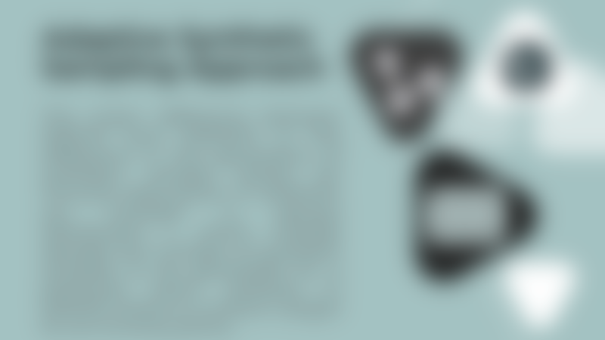

Slide 41
Notes:
Lets take an example so we have have here our imblanaced data , the blue circles are the majority class and the orange squares are the minority class , as you can see here the newly generated data is always within the same area , this will prevent outlier and nisy data generation

Slide 42

Polynomial Fitting: Star Topology
In this approach, we generate a synthetic instance arranged as a star silhouette. First, we consider a n*m minority class matrix in which line * column = (n feature values * m instances).

Slide 43

Polynomial Fitting: Star Topology
Second, we define a group of linear functions f_{i}(x) for connecting each feature value to the mean of all ones
f_{i} (x)=a_{i}x + b_{i}

Slide 44
Polynomial Fitting: Star Topology
Then, we identify the coefficients a_{i} and b_{i} in a way that each function f_{i}(x) fits the mean value and the data. After that, we generate k linearly-spaced value according to the oversampling rate.

Slide 45


Slide 47
Notes:
So this is ur data the shape u see here is the centroid of minority class, we generatethe linear functions passing by the centroid and each data point, n these lines, we will generate our synthetic data

Slide 48

Polynomial Fitting: Bus Topology
This approach is based on interpolation. First, for each feature of the minority class matrix, we plot a straight line connecting one minority data to the next. The single line connecting two succeeding data is described generally by the following linear function: f_{i} (x)=ax + b

Slide 49

Polynomial Fitting: Bus Topology
Then, we identify the coefficients “a” and “b” in such a way that f(x) fits the data. Next, we generate k linearly-spaced values according to the oversampling rate.

Slide 50
Polynomial Fitting: Bus Topology
Finally, the new synthetic minority samples are created between each two succeeding data by evaluating the value of the function f_{i} (x) at x_{k}
.

Slide 52
Notes:
So here is our data again , first we plot a straight line connecting one minority data to the next in order to make it a bus topology and then we generate k linearly-spaced values on those lines

Slide 54

Polynomial Fitting: Mesh Topology
This approach based on interpolation is a process for which each feature of the minority class matrix we plot a set of straight lines connecting one minority data to all others. For each single line connecting two data we proceed as stated in Bus topology concerning the synthetic data addition.

Slide 55
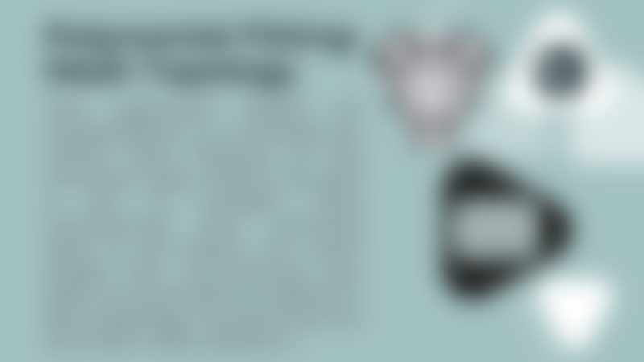

Slide 57

Question :
How many SMOTE algorithms do exist?
1
5
10
Surprising answer:
MORE THAN 85 IMPLEMENTATIONS

Slide 58
Polynomial fit SMOTE
Selected SMOTE
K-Means SMOTE
Distance SMOTE
Safe Level SMOTE
Density based SMOTE
Borderline SMOTE
Genetic Algorithm based SMOTE
Notes:
Other models

Slide 59
https://github.com/gykovacs/smote_variants
Notes:
Visit this git repsitory to read about more implementations on smte variants

Slide 60
https://github.com/gykovacs/smote_variants

Slide 61
SMOTE+TOMEK
Tomek links can be used as an under-sampling method or as a data cleaning method. Tomek links to the over-sampled training set as a data cleaning method. Thus, instead of removing only the majority class examples that form Tomek links, examples from both classes are removed
Notes:
Until noz we have seen some different approachs n the dwnsampling and oversampling techniques , there is also the hybrid technque which consist of combining the oversampling and downsampling together . Lets take a look on this hybrid approach that combine the smte with the tomek links,
Cleaning method cuz it Removes the instances of the majority class that are very close to the minority class as we saw before

Slide 62
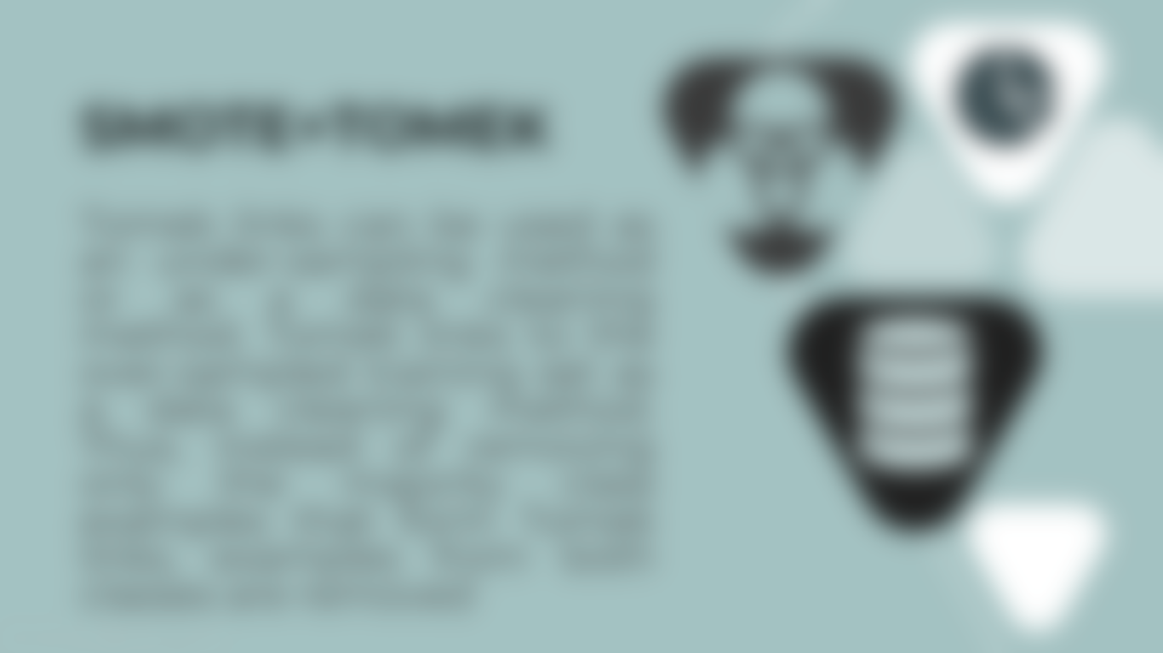

Slide 63
Notes:
So here is our imbalanced data this hybrid approach uses the tomek links to remove some points of the majority class and uses the smote to generate new data point of the minority class its really a simple concept its just a combinatin between the 2 methods that we saw before

Slide 64
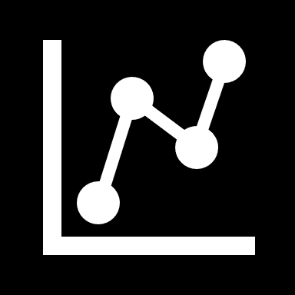
Reworking models
Tree based models
Evaluation metrics
Ensemble methods

Slide 65
Question to start with:
How do you measure the performance of a model?
Classic answer:
ACCURACY!

Slide 66
Other metrics to measure model performance
how trustable is the result when the model answer that a point belongs to that class
how well the model is able to detect that class
the harmonic mean of precision and recall
ROC
AUROC
Precision
F1 - Score
Recall
Receiver operating characteristic
Area Under the ROC

Slide 67
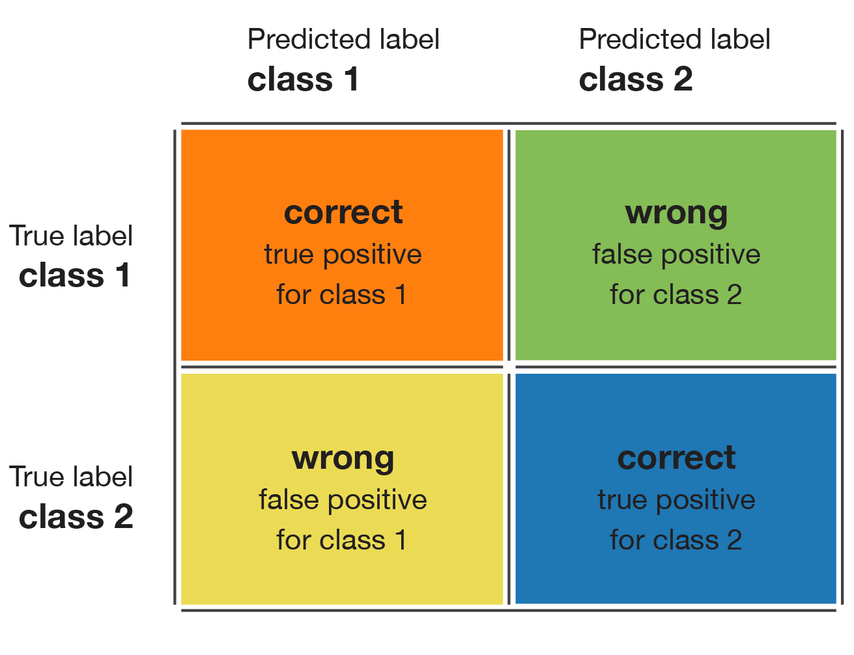
Confusion matrix

Slide 68
Metrics based judgement
Recall
Precision

Slide 69
Metrics based judgement
RECALL: HIGH
PRECISION: HIGH
the class is perfectly handled by the model
Recall
Precision

Slide 70
Metrics based judgement
RECALL: LOW
PRECISION: HIGH
the model can’t detect the class well but is highly trustable when it does
Recall
Precision

Slide 71
Metrics based judgement
RECALL: HIGH
PRECISION: LOW
the class is well detected but the model also includes points of other classes in it
Recall
Precision

Slide 72
Metrics based judgement
RECALL: LOW
PRECISION: LOW
the class is poorly handled by the model
Recall
Precision

Slide 73
ROC (Receiver Operating Characteristic)
Suppose that for a given point x, we have a model that outputs the probability that this point belongs to C: P(C | x). Based on this probability, we can define a decision rule that consists in saying that x belongs to class C if and only if P(C | x)≥T, where T is a given threshold defining our decision rule. If T=1, a point is labelled as belonging to C only if the model is 100% confident it does. If T=0, every point is labelled as belonging to C.

Slide 74
ROC Curve
Each value of the threshold T generates a point (false positive, true positive) and, then, the ROC curve is the curve described by the ensemble of points generated when T varies from 1 to 0.
This curve starts at point (0,0), ends at point (1,1) and is increasing. A good model will have a curve that increases quickly from 0 to 1 (meaning that only a little precision has to be sacrificed to get a high recall).
Notes:
1 – Negative Recall = Specifity

Slide 75
Area Under ROC
P(x|C1)P(C1)
P(x|C1)
P(x|C0)P(C0)
P(x|C0)

Slide 76
AUROC
P(x|C1)P(C1)
P(x|C1)
P(x|C0)P(C0)
P(x|C0)
Notes:
In the given example, we can observe that the two classes are not well separable (they are not far apart from each other). However, we can notice that facing an imbalanced dataset doesn’t necessarily mean that the two classes are not well separable and, so, that the classifier can’t do a pretty good job on the minority class. For example, consider that we still have two classes C0 (90%) and C1 (10%). Data in C0 follow a one dimensional Gaussian distribution of mean 0 and variance 4 whereas data in C1 follow a one dimensional Gaussian distribution of mean 10 and variance 1. If we plot the data as before, we then have

Slide 77
AUROC
P(x|C1)P(C1)
P(x|C1)
P(x|C0)P(C0)
P(x|C0)
Notes:
Here we see that contrarily to the previous case the C0 curve is not always above the C1 curve and, so, there are points that are more likely to be drawn from class C1 than from class C0. In this case, the two classes are separated enough to compensate the imbalance: a classifier will not necessarily answer C0 all the time.

Slide 78
AUROC - THEORETICAL MINIMAL ERROR
Not separable
P(x|C1)P(C1)
P(x|C0)P(C0)
Notes:
Finally, we should keep in mind that a classifier has a theoretical minimal error probability. For a classifier of this kind (one feature, two classes), we can mention that, graphically, the theoretical minimal error probability is given by the area under the minimum of the two curves.
Illustration of the theoretical minimal error for different degree of separability of two classes.

Slide 79
AUROC - THEORETICAL MINIMAL ERROR
Slightly separable
P(x|C1)P(C1)
P(x|C0)P(C0)

Slide 80
AUROC - THEORETICAL MINIMAL ERROR
Well separable
P(x|C1)P(C1)
P(x|C0)P(C0)

Slide 82
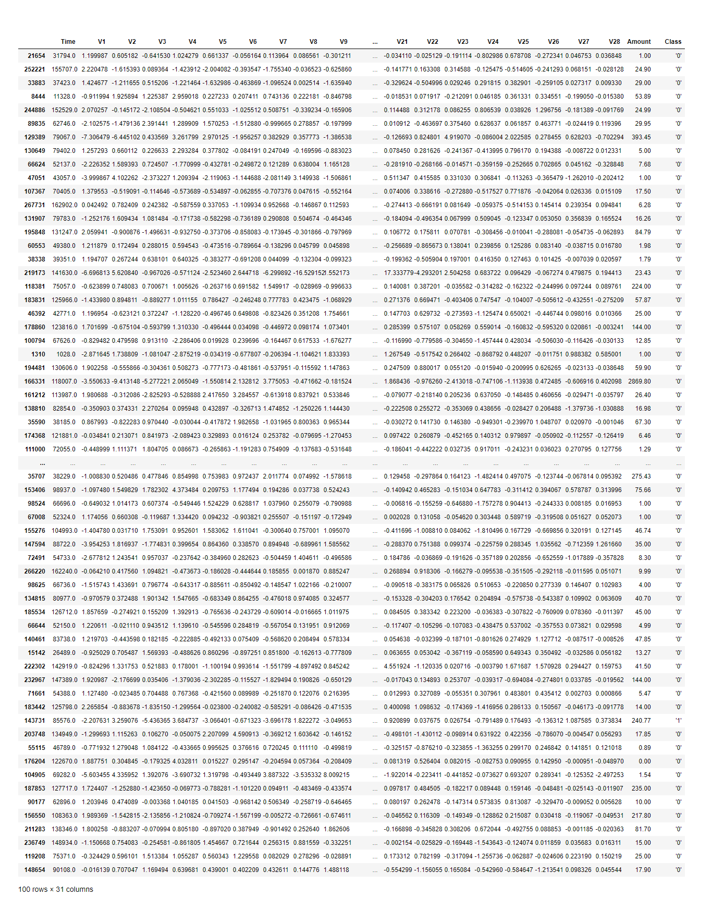

Slide 83
THERE’S ALWAYS SOME ONE
IN A WORLD FULL OF ZEROS
Decision trees frequently perform well on imbalanced data. They work by learning a hierarchy of if/else questions and this can force both classes to be addressed.

Slide 85
Notes:
What you see here is .. A forest! In machine learning the word forest refers us to Random Forest which belongs to the family of ensemble methods

Slide 86

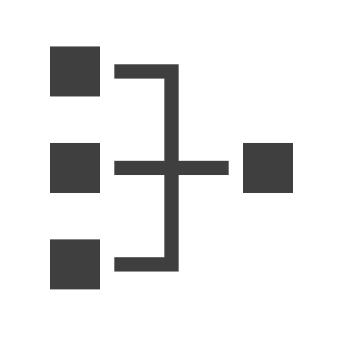
Sequential methods
Based on boosting
These methods take advantage of the dependency between the base learners . Just like the classroom of students discussing a problem and getting the solution by complementing on the answers of the other students, the base learners complement the results of their base learners.
These methods take advantage of the independence between the base learners. These methods take a path of democracy. Some algorithms allow the base learners to make predictions then picks the prediction which has the highest vote. Those are commonly known as voting methods.
Parallel methods
Based on bootstrapping
Notes:
in sequantial methods the models are built in series. In each successive model , the weight are adjusted based on the learning of previous model
in parallel methods various models are built in parallel on various samples an then the various models vte to give the final mdel and hence prediction.

Slide 87
Only by resampling the data repeatedly, randomness can be introduced into the dataset to make sure that there won’t be an overfitting problem.
The easiest way to successfully generalize a model is by using more data. The problem is that out-of-the-box classifiers like logistic regression tend to generalize by discarding the rare class. One easy best practice is building n models that use all the samples of the rare class and n-differing samples of the abundant class. Given that you want to ensemble 10 models, you would keep e.g. the 1.000 cases of the rare class and randomly sample 10.000 cases of the abundant class. Then you just split the 10.000 cases in 10 chunks and train 10 different models. This approach is simple and perfectly horizontally scalable if you have a lot of data, since you can just train and run your models on different cluster nodes. Ensemble models also tend to generalize better, which makes this approach easy to handle.

Slide 88
Random Forests
A forest = many trees
Since it is an algorithm that relies on bagging, it combines several weak learners (here decision trees) and makes a kind of vote to be able to make a prediction, the goal of using this algorithm is to improve the time of performance while maintaining a high reliability rate.

Slide 89


Bootstrapping part
After creating several trees, each one returns a classification and the model makes a vote to know which of the answers will be taken into consideration.

Slide 90


Decision: YES
3 NO
5
YES

Slide 91


Slide 93
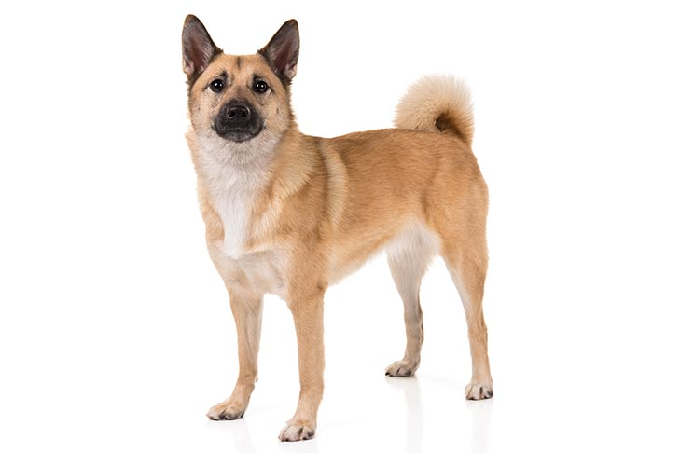

Slide 95
GAN

Slide 97
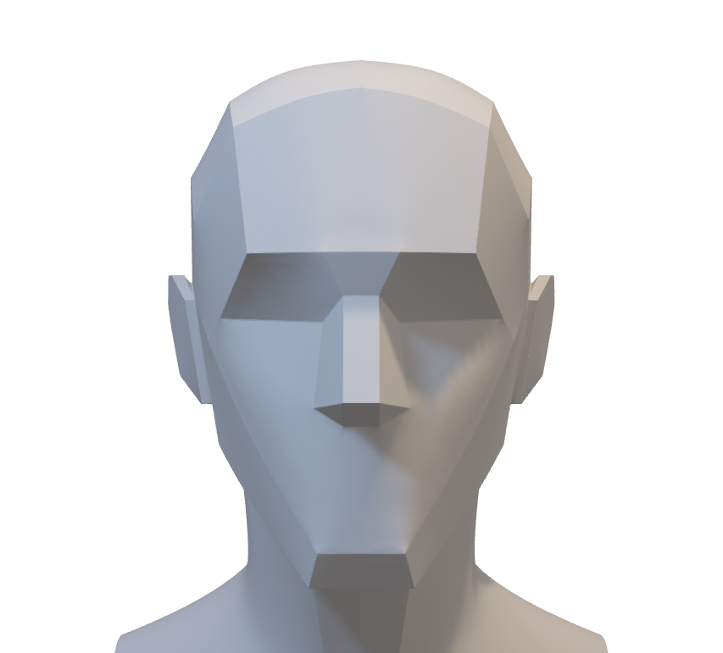
Usage of GAN in real-life cases
In criminology (facial composite)
Instead of extracting characteristics from a face (eyes color, nose shape, hairstyle…) and classify them (e.g. green or brown eyes), we can generate a face with these characteristics using GAN (Generative adversarial network) as it takes as input the desired label and returns a feature vector
Think of it as the reverse of a classic neural network

Slide 98


Paper readings

Slide 99
CatBoost: unbiased boosting with categorical features
Submitted on June 28th, 2017, last revised Jan 20th, 2019
This paper presents the key algorithmic techniques behind CatBoost, a new gradient boosting toolkit. Their combination leads to CatBoost outperforming other publicly available boosting implementations in terms of quality on a variety of datasets. Two critical algorithmic advances introduced in CatBoost are the implementation of ordered boosting, a permutation-driven alternative to the classic algorithm, and an innovative algorithm for processing categorical features. Both techniques were created to fight a prediction shift caused by a special kind of target leakage present in all currently existing implementations of gradient boosting algorithms. In this paper, we provide a detailed analysis of this problem and demonstrate that proposed algorithms solve it effectively, leading to excellent empirical results.

Slide 100
Deep Learning for Imbalance Data Classification using Class Expert Generative Adversarial Network (GAN)
Submitted on Aug 29th, 2018
Without any specific way for imbalance data classification, artificial intelligence algorithm cannot recognize data from minority classes easily. In general, modifying the existing algorithm by assuming that the training data is imbalanced, is the only way to handle imbalance data. However, for a normal data handling, this way mostly produces a deficient result. In this research, we propose a class expert generative adversarial network (CE-GAN) as the solution for imbalance data classification. CE-GAN is a modification in deep learning algorithm architecture that does not have an assumption that the training data is imbalance data. Moreover, CE-GAN is designed to identify more detail about the character of each class before classification step. CE-GAN has been proved in this research to give a good performance for imbalance data classification.

Slide 101
Handling Imbalanced Dataset in Multi-label Text Categorization using Bagging and Adaptive Boosting
Submitted on Oct 27th, 2018, last revised Jun 11th, 2019
Bagging and Adaptive Boosting algorithms are employed to handle the issue and improve the performance of text categorization. The result is evaluated with four evaluation metrics such as hamming loss, subset accuracy, example-based accuracy and micro-averaged f-measure. Bagging ML-LP with SMO weak classifier is the best performer in terms of subset accuracy and example-based accuracy. Bagging ML-BR with SMO weak classifier has the best micro-averaged f-measure among all. In other hand, AdaBoost MH with J48 weak classifier has the lowest hamming loss value. Thus, both algorithms have high potential in boosting the performance of text categorization, but only for certain weak classifiers. However, bagging has more potential than adaptive boosting in increasing the accuracy of minority labels.

Slide 102
Deep Reinforcement Learning for Imbalanced Classification
Submitted on Jan 5th, 2019
Data in real-world application often exhibit skewed class distribution which poses an intense challenge for machine learning. Conventional classification algorithms are not effective in the case of imbalanced data distribution and may fail when the data distribution is highly imbalanced. To address this issue, we propose a general imbalanced classification model based on deep reinforcement learning. We formulate the classification problem as a sequential decision-making process and solve it by deep Q-Learning network. The agent performs a classification action on one sample at each time step, and the environment evaluates the classification action and returns a reward to the agent. The reward from minority class sample is larger so the agent is more sensitive to the minority class. The agent finally finds an optimal classification policy in imbalanced data under the guidance of specific reward function and beneficial learning environment. Experiments show that our proposed model outperforms the other imbalanced classification algorithms, and it can identify more minority samples and has great classification performance

Slide 103
WOTBoost: Weighted Oversampling Technique in Boosting for imbalanced learning
Submitted on Oct 17th, 2019, last revised Nov 1st, 2019
A good number of research works have been reported to tackle this challenging problem. For example, Synthetic Minority Over-sampling TEchnique (SMOTE) and ADAptive SYNthetic sampling approach (ADASYN) use oversampling techniques to balance the skewed datasets. In this paper, we propose a novel method that combines a Weighted Oversampling Technique and ensemble Boosting method (WOTBoost) to improve the classification accuracy of minority data without sacrificing the accuracy of the majority class. WOTBoost adjusts its oversampling strategy at each round of boosting to synthesize more targeted minority data samples. The adjustment is enforced using a weighted distribution.

Slide 106
Thank you for attention
Turn your machines on!

Slide 107
Notes:
WHAT IS WEIGHTED REGRESSION?
Weighted regression is a method that you can use when the least squares assumption of constant variance in the residuals is violated (heteroscedasticity). With the correct weight, this procedure minimizes the sum of weighted squared residuals to produce residuals with a constant variance (homoscedasticity).
IMPORTANT
Weighted regression is not an appropriate solution if the heteroscedasticity is caused by an omitted variable.

Slide 108
ΥΧΑΡΙΣΤΩ

Slide 109
감사합니다

Slide 110
DANKE

Slide 111
OBRIGADO

Slide 112
GRACIAS

Slide 113
شكرا

Slide 114
MERCI

Slide 115
THANK

Slide 116
THANK YOU

